Slide 1
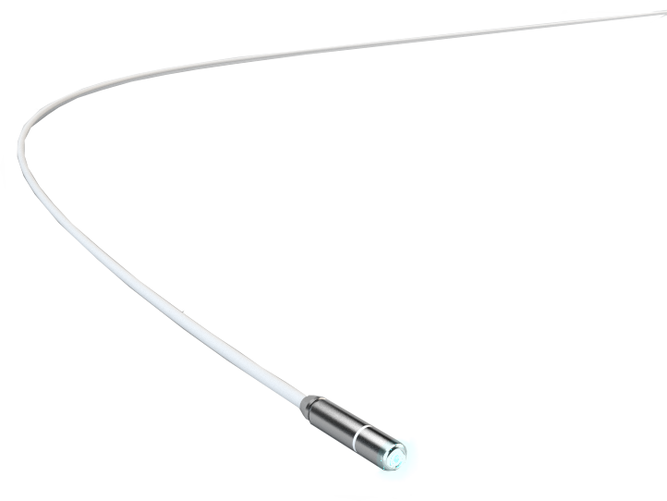


probe-based Confocal Laser Endomicroscopy (pCLE)
&
needle-based Confocal Laser Endomicroscopy (nCLE)
See clearly, act faster
Physician Speaker Presentation - INT - V1.03 - Dec 2015

Slide 2
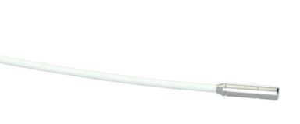
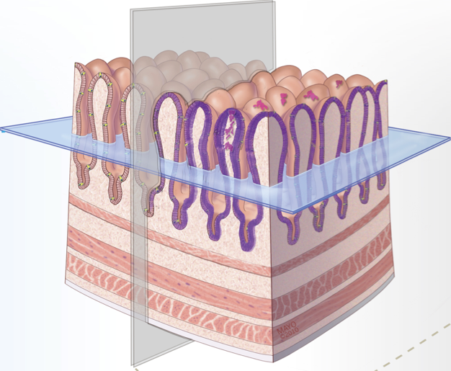
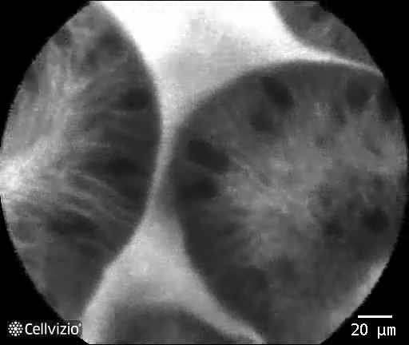
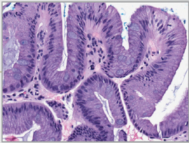
What is Confocal Laser Endomicroscopy ?
Optical Biopsy
Physical Biopsy
En-face view
In-vivo
Microscopic
Minimally invasive
Instantaneous imaging
Transverse view
Ex-vivo
Microscopic
Invasive
Delayed imaging

Slide 3
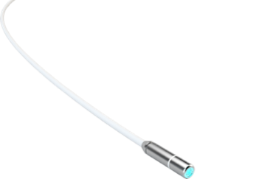
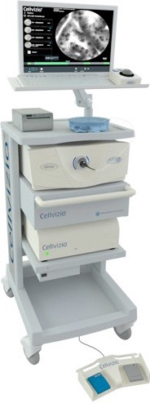
The Confocal Laser Endomicroscopy technology
  Probe-based and needle-based microscope used during endoscopic procedures
  Compatible with existing endoscopes and endoscopic accessories
  Minimally invasive microscopic images of tissue, available in real-time
  Access the Gastro-Intestinal, Respiratory and Urinary systems
  Different probes for different indications
The Cellvizio® Systems are regulated Medical Device, CE marked (Class IIa - NB : LNE/G-MED) and FDA cleared; Cellvizio systems are intended to allow confocal laser imaging of the internal microstructure of tissues in anatomical tracts, i.e. gastrointestinal, respiratory or urinary, accessed through an endoscope or endoscopic accessories. These statements and the associated references to specific clinical studies, are not intended to represent claims of safety or effectiveness for detecting or treating any specific condition or disease state. Rather this information is intended to provide useful reference to selected published literature describing physician experiences with the associated clinical uses. These statements have not been reviewed, cleared, or approved by the U.S. FDA. Please note that the interpretation criteria are suggested descriptive features and do not represent definitive diagnostic landmarks and are a result of input from trained and well qualified person. Any diagnostic assessment should always be made by the attending physician, based on the evaluation of all sources of clinical, endoscopic and other relevant information. Please consult labels and instructions for use.

Slide 4
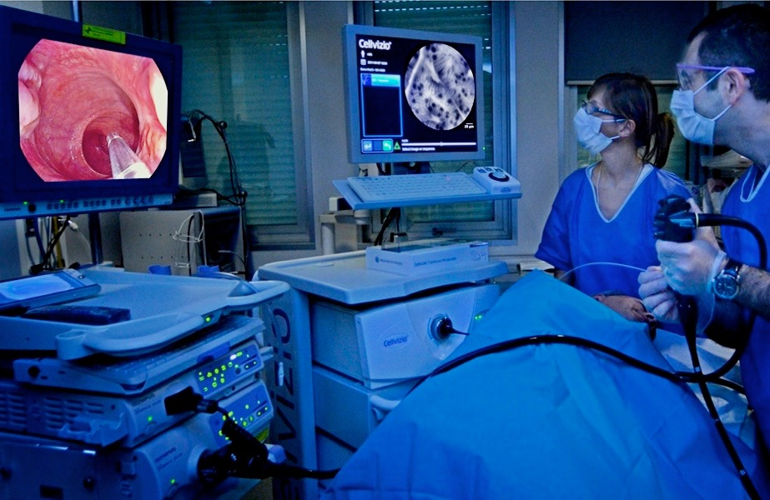
Real time microscopic imaging
3
Cellvizio video displayed in real-time
2
1
Probe appears on endoscopic image
Probe positioned in contact with mucosa
Area of interest identified during endoscopic procedure
Cellvizio Probe introduced into the working channel of the endoscope

Slide 5
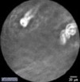
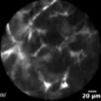
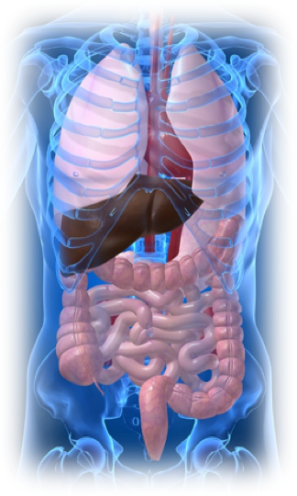





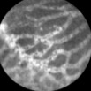





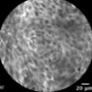
A wealth of applications
Esophagus
Thyroid*
Stomach
Bronchi
Bilio-pancreatic ducts
Alveoli
Pancreas
Liver*
Small Bowel
Upper urinary tract
Colon
Bladder
Rectum
Cervix*
*Images obtained during research and clinical studies - these indications have not been cleared by regulatory authorities

Slide 6
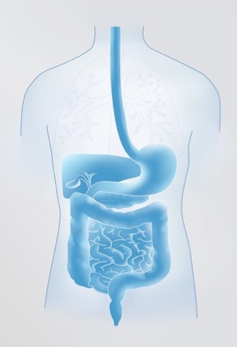
Main targeted indications in the Gastrointestinal Tract
Barrett’s Esophagus
Gastric Diseases
Bilio-Pancreatic Strictures
Pancreatic Cysts
Colorectal Lesions
Inflammatory Bowel Disease

Slide 7
Barrett’s Esophagus

Slide 8
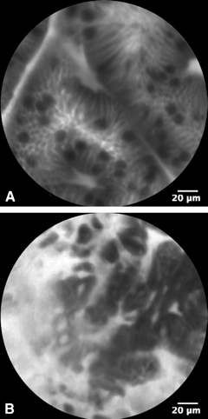
Cellvizio DONT BIOPCE study 1/2
Objectives
  To evaluate the sensitivity and specificity of pCLE added to white light endoscopy (WLE) for the detection of high grade dysplasia (HGD) and early cancer (EC)
Non dysplastic BE
Study Design
Dysplastic BE
  Prospective multi-center randomized controlled study
  5 centers (tandem design: 2 endoscopists at each center)
  Centralized pathology
  Evaluated 101 patients undergoing Barrett’s Esophagus surveillance or treatment evaluation
Sharma P. et al.,Real-time Increased Detection of Neoplastic Tissue in Barrett's Esophagus with probe-based Confocal Laser Endomicroscopy: Final Results of a Multi-center Prospective International Randomized Controlled Trial. GIE, 2011.

Slide 9
Cellvizio DONT BIOPCE study 2/2
Results
Sensitivity for the detection of dysplastic lesions
Location based
ALL Locations (n=874) Prevalence = 7% | Sensitivity | Specificity | PPV | NPV
WLE | 34 % | 93 % | 43 % | 90 %
WLE or NBI | 45 % | 88 % | 38 % | 91 %
WLE or pCLE | 68 % | 88 % | 47 % | 95 %
WLE or NBI or pCLE | 76 % | 84 % | 43 % | 96 %
p=0.01
p=0.01
Patient based
ALL Patients (n=101) | Sensitivity | Specificity | PPV | NPV | Areas with HGD/EC missed
WLE | 87 % | 71 % | 57 % | 93 % | 4 (13%)
WLE or NBI | 97 % | 56 % | 49 % | 98 % | 1 (3%)
WLE or pCLE | 94 % | 67 % | 56 % | 96 % | 2 (6%)
WLE or NBI or pCLE | 100 % | 56 % | 50 % | 100 % | 0 (0%)
Addition of pCLE is twice as sensitive as WLE alone, and 1.7 times as sensitive as WLE & NBI to detect dysplasia
Use of pCLE resulted in detection of ALL HGD/EC patients (100% Sensitivity)
Using pCLE in addition to WLE & NBI, 39% of patients could be spared biopsies completely (NPV = 100%)
Sharma P. et al.,Real-time Increased Detection of Neoplastic Tissue in Barrett's Esophagus with probe-based Confocal Laser Endomicroscopy: Final Results of a Multi-center Prospective International Randomized Controlled Trial. GIE, 2011.

Slide 10
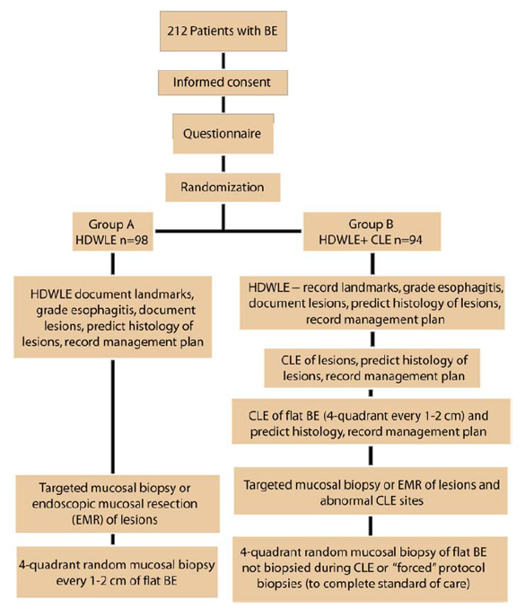
Canto et al. Study 1/2
Objectives
  To compare HDWLE with random biopsy (standard approach of Seattle protocol) with HDWLE + eCLE and targeted biopsy
Study Design
  Prospective multi-center randomized controlled study
  5 centers
  Centralized pathology
  Evaluated 192 patients undergoing Barrett’s Esophagus surveillance or referred for early neoplasia, randomized to Arm 1 (HDWLE + random biopsy) or Arm 2 (HDWLE + eCLE + targeted biopsy)
Canto M. et al., In vivo endomicroscopy improves detection of Barrett’s esophagus–related neoplasia: a multicenter international randomized controlled trial. GIE, 2013

Slide 11
Canto et al. Study 2/2
Results
Sensitivity for the detection of neoplasia in BE patients
Tripled diagnostic yield of physical biopsies for neoplasia, with 22% of biopsies showing dysplasia for targeted sampling, compared to 6% for random sampling, while decreasing the number of physical biopsies by 80%
Changed the treatment plan in 36% of patients
Location based
Per-biopsy analysis (n=978) | Sensitivity | Specificity | PPV | NPV | Accuracy
HDWLE | 10 % | 99 % | 67 % | 94 % | 93 %
HDWLE with CLE | 86 % | 93 % | 65 % | 98 % | 92 %
p<0.0001
p:=0.006
Study results show that HDWLE + CLE targeted biopsies surpasses the PIVI threshold, supporting its use as an approach to BE surveillance:
Increased the Sensitivity for neoplasia detection from 40% to 95%
Increased the NPV from 90% to 98%
Patient based
Per-patient analysis (n=192) | Sensitivity | Specificity | PPV | NPV | Accuracy
HDWLE | 40 % | 98 % | 75 % | 90 % | 89 %
HDWLE with CLE | 95 % | 92 % | 77 % | 98 % | 93 %
p<0.0001
p:=0.005
Canto M. et al., In vivo endomicroscopy improves detection of Barrett’s esophagus–related neoplasia: a multicenter international randomized controlled trial. GIE, 2013

Slide 12
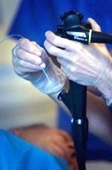
Bertani et al. Study 1/2
Objectives
  To evaluate the dysplasia detection rate in BE patients under surveillance for WLE with standard random biopsy (standard approach of Seattle protocol) and WLE + pCLE and standard random biopsy
Study Design
  Prospective single-center randomized controlled study
  Blinded gastrointestinal pathologist for the diagnosis of dysplasia
  Evaluated 100 patients undergoing Barrett’s Esophagus surveillance, randomized to Arm 1 (HDWLE + random biopsy) or Arm 2 (HDWLE + pCLE + random biopsy)
Bertani H. et al. Improved Detection of Incident Dysplasia by pCLE in a BE Surveillance Program. Dig Dis Sci, 2013

Slide 13
Bertani et al. Study 2/2
Results
The dysplasia detection rate was significantly higher in the pCLE group (28%) than in the HD-WLE group (10%) (p=0.04)
Biopsies could have been avoided in 58% of patients with a targeted biopsy approach, based on the 100% NPV of pCLE
Dysplasia detection rate
(diagnostic yield of biopsies)
Per-patient analysis (n=100) | Sensitivity | Specificity | PPV | NPV | Diagnostic yield of biopsies
HDWLE | Not published |  |  |  | 10 %
HDWLE + pCLE | 100 % | 83 % | 67 % | 100 % | 28 %
p=0.04
Bertani H. et al. Improved Detection of Incident Dysplasia by pCLE in a BE Surveillance Program. Dig Dis Sci, 2013

Slide 14
Gastric Diseases

Slide 15
Pittayanon et al. Gastric Intestinal Metaplasia Study 1/2
Objectives
  To assess the diagnostic yield of magnifying Flexible Spectral Imaging Color Enhancement (ME-FICE) + pCLE for Gastric Intestinal Metaplasia (GIM) detection
Study Design
  Prospective, blind comparison of pCLE with ME-FICE (using light blue crest, large long crest and villous pattern as criteria) on gastric lesions
  Single center
  Evaluated 60 patients with previous histology confirmed as GIM undergoing a surveillance EGD
  Standard and 100x ME-FICE used for screening of lesions, and pCLE used to confirm the presence of GIM. ME-FICE and pCLE results then compared with final histopathology of biopsies
Pittayanon R. et al. Flexible Spectral Imaging Color Enhancement plus probe-based Confocal Laser Endomicroscopy for Gastric Intestinal Metaplasia Detection. Journal of Gastroenterology and Hepatology, 2013.

Slide 16
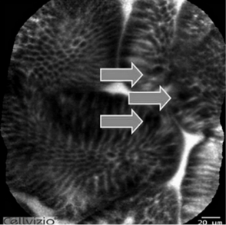
Pittayanon et al. Gastric Intestinal Metaplasia Study 2/2
Results
Adding pCLE to ME-FICE increases accuracy for the detection of Gastric Intestinal Metaplasia (GIM) to 92,5%
Accuracy of detection of GIM
All locations (n=60) | Sensitivity | Specificity | PPV | NPV | Accuracy
ME-FICE | 95.6 % | 79.2 % | 74.5 % | 96.7 % | 85.8 %
ME-FICE + pCLE | 96.5 % | 90.5 % | 86.2 % | 97.1 % | 92.5 %
Gastric Intestinal Metaplasia, evidenced by the presence of goblet cells (arrows)
Pittayanon R. et al. Flexible Spectral Imaging Color Enhancement plus probe-based Confocal Laser Endomicroscopy for Gastric Intestinal Metaplasia Detection. Journal of Gastroenterology and Hepatology, 2013.

Slide 17
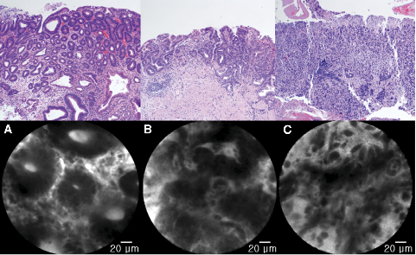
Bok et al. Early Gastric Cancer Study 1/2
Objectives
  To compare the accuracy of conventional endoscopic forceps biopsy and pCLE for the diagnosis of superficial gastric neoplasia before endoscopic resection
Study Design
Gastric dysplasia
Differentiated adenocarcinoma
Undifferentiated adenocarcinoma
  Prospective, blind comparison of pCLE imaging with forceps biopsy using endoscopic resection as reference standard
  Single center
  Evaluated 46 patients undergoing endoscopic resection of gastric lesions (54 lesions in total) post diagnostic evaluation with pCLE and biopsies of suspicious areas. Biopsy and pCLE results were then compared with final histopathology of specimens
Bok G.H. et al. The Accuracy of probe-based Confocal Endomicroscopy versus Conventional Endoscopic Biopsies for the Diagnosis of Superficial Neoplasia (with videos). Gastro-Intestinal Endoscopy, 2013.

Slide 18
Bok et al. Early Gastric Cancer Study 2/2
Results
Forceps biopsy misses cancerous lesions, with a sensitivity at 75% only
Adding pCLE increases sensitivity and NPV of neoplasia detection in the stomach to >95%
The overall accuracy of forceps biopsy + pCLE reaches 98,1%, compared to 85,2% for forceps biopsy alone
Detection of gastric neoplasia
All locations (n=54) | Sensitivity | Specificity | PPV | NPV | Accuracy
Forceps Biopsy | 75.0 % | 100.0 % | 100.0 % | 73.3 % | 85.2 %
pCLE | 90.6 % | 90.9 % | 93.5 % | 87.0 % | 90.7 %
Forceps Biopsy + pCLE | 96.9 % | 100.0 % | 100.0 % | 95.7 % | 98.1 %
Bok G.H. et al. The Accuracy of probe-based Confocal Endomicroscopy versus Conventional Endoscopic Biopsies for the Diagnosis of Superficial Neoplasia (with videos). Gastro-Intestinal Endoscopy, 2013.

Slide 19
Li et al. New pCLE Classification Study 1/2
Objectives
  To propose a new probe-based confocal laser endomicroscopy (pCLE) classification of gastric pit patterns and vessel architecture, and to assess the accuracy and inter-observer
  agreement
Study Design
  Prospective, single center, blind evaluation of pCLE using biopsy as reference standard
  Two phase design:
    Phase 1: establishment of a new pCLE classification based on 291 videos from 32 patients
    Phase 2: Evaluation of 240 patients (1878 locations) using HDWLE and pCLE at 7 standardized locations + endoscopic suspected lesions. pCLE results were then compared with final histopathology of specimens
  Live pCLE evaluation by 1 endoscopist and blinded offline pCLE evaluation by 3 other endoscopists for Inter-Observer Agreement (IOA) calculation
Li Z. et al. New Classification of Gastric Pit Patterns and Vessel Architecture Using Probe-based Confocal Laser Endomicroscopy. J Clin Gastroenterol 2015

Slide 20
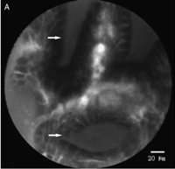
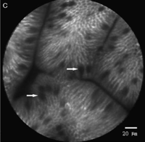
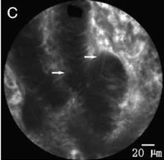
Li et al. New pCLE Classification Study 2/2
Results
New pCLE classification of pit patterns and vessel architecture in the stomach correlates well with histopathology, with specificities over 99% and sensitivities ranging from 89% to 92% for the diagnosis of Atrophic Gastritis, GIM and Gastric Neoplasia
IOA “substantial” for the differentiation of neoplasia vs. non-neoplasia (K=0.70)
Atrophic Gastritis
GIM
Gastric Neoplasia
pCLE diagnosis of gastric lesions
All locations (n=1878) | Sensitivity |  | Specificity
pCLE diagnosis for: | Real-time | Offline | Real-time | Offline
Atrophic Gastritis type 2b pit pattern | 88.51 % | 89.86 % | 99.19 % | 99.25 %
GIM type 2C pit pattern | 92.34 % | 93.69 % | 99.34 % | 99.40 %
Gastric Neoplasia type 3 pit pattern & vessel architecture | 89.89 % | 92.13 % | 99.44 % | 99.50 %
Li Z. et al. New Classification of Gastric Pit Patterns and Vessel Architecture Using Probe-based Confocal Laser Endomicroscopy. J Clin Gastroenterol 2015

Slide 21
Bilio-Pancreatic Strictures

Slide 22
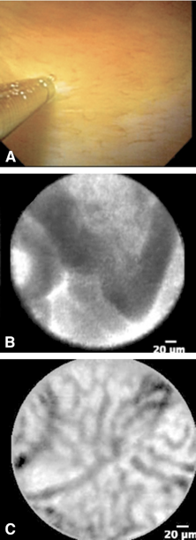
ERCP Registry Study 1/2
Objectives
A: Cholangioscopical image of pCLE probe attached onto the
mucosa of the common bile duct
  To evaluate the efficacy of pCLE for differentiating malignant from benign bilio-pancreatic stricture
B: pCLE image of malignant mucosa, showing epithelial structures with thick dark bands
Study Design
  Prospective observational multi-center registry (5 centers)
  Enrolled 102 patients, evaluated 89
  Probe introduced via cholangiopancreatoscope (CP) or catheter
  Clinical, ERCP, tissue sampling and pCLE data collected prospectively
  FU > 30 days until confirmation of malignancy, 1 year FU otherwise
C: pCLE image of benign mucosa, showing a reticular pattern with
thin dark bands
Meining A. et al., Direct visualization of indeterminate pancreaticobiliary strictures using probe based Confocal Laser Endomicroscopy - A multi-center experience. Gastrointestinal Endoscopy. GIE 2011

Slide 23
ERCP Registry Study 2/2
Results
Out of 40 malignant patients in the cohort:
  pCLE detected 39 malignant patients in real time
  Index pathology detected 18 malignant patients
In terms of overall accuracy of the ERCP examination, the added value of pCLE was superior to that of tissue sampling
Sensitivity of detection of biliopancreatic malignancy
All patients (n=89) Prevalence= 45% | Sensitivity | Specificity | PPV | NPV | Accuracy
Tissue sampling | 45 % | 100 % | 100 % | 69 % | 75 %
pCLE | 98 % | 67 % | 71 % | 97 % | 81 %
ERCP & Tissue sampling | 40 % | 100 % | 100 % | 67 % | 73 %
ERCP & pCLE | 85 % | 94 % | 92 % | 89 % | 90 %
p<0.001
p<0.001
Meining A, et al., Direct visualization of indeterminate pancreaticobiliary strictures using probe based Confocal Laser Endomicroscopy - A multi-center experience. Gastrointestinal Endoscopy. GIE 2011

Slide 24
Paris Classification 1/2
Objectives
  The Paris Classification is a refinement of the existing Miami Classification to improve the specificity of pCLE for diagnosing benign inflammatory strictures.
Study Design
  Retrospective review of prospective registry cases
  60 cases (27 malignant, 33 benign)
  Each case’s clinical history, ERCP impression, and corresponding pCLE sequences were used to score image quality, propose presumptive diagnoses, and rate level of diagnostic confidence.
  3 investigators
Caillol, F. et al. Refined Probe-Based Confocal Laser Endomicroscopy Classification for Biliary Strictures: The Paris Classification, Dig dis Sci, 2013

Slide 25
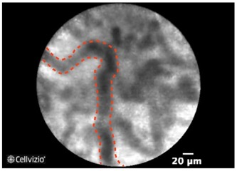
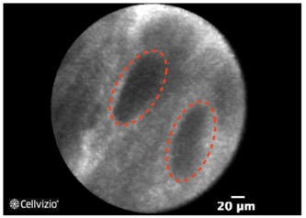
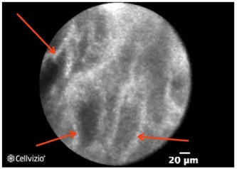
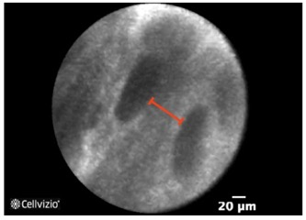
Paris Classification 2/2
Results
Specificity of pCLE for the detection of biliopancreatic malignancy
Identified 4 descriptive criteria specific to benign inflammatory conditions (illustrations below)
Improved specificity using the Paris classification for the characterization of inflammatory strictures
Thickened reticular structures
Dark granular pattern in scales
Multiple white bands
Increased space between scales
Caillol, F. et al. Refined Probe-Based Confocal Laser Endomicroscopy Classification for Biliary Strictures: The Paris Classification, Dig dis Sci, 2013

Slide 26
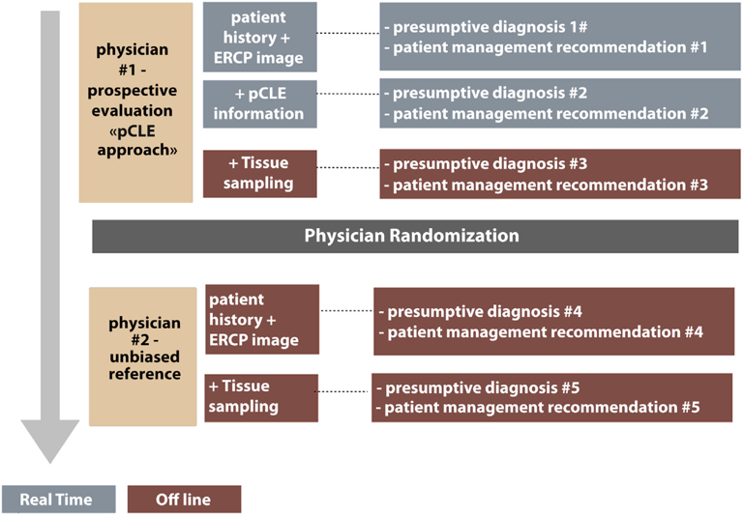
FOCUS Study 1/2
Objectives
  To prospectively validate the diagnostic performance of pCLE, including inflammatory Paris criteria, in the detection of biliary cancer and compare it with the performance of alternative diagnostic strategies
Study Design
  Prospective observational multi-center study
  (6 centers)
  Enrolled 136 patients, evaluated 112 patients
  (71 malignant, 41 benign)
  Clinical, ERCP, tissue sampling and pCLE data collected prospectively
  6months to 1 year FU for all patients
Slivka, A. et al. Validation of the diagnostic accuracy of pCLE for the characterization of indeterminate biliary strictures: results of a prospective multi-center international study, GI Endoscopy, 2015

Slide 27




FOCUS Study 1/2
Results
Tissue sampling detected 40 patients with cancer, and was inconclusive for 63% (n=72) of patients
In patients with indeterminate tissue sampling, ERCP and pCLE
  detected 24 additional patients with cancer
  ruled out cancer in 30 patients with benign strictures
  leaving only 18 patients indeterminate in the end
All patients (n=112) Prevalence= 63% | Sensitivity | Specificity | PPV | NPV | Accuracy
Tissue sampling | 56 % | 100 % | 100 % | 57 % | 72 %
ERCP + Tissue sampling | 85 % | 69 % | 83 % | 73 % | 79 %
ERCP + pCLE | 89 % | 71 % | 84 % | 78 % | 82 %
ERCP + Tissue sampling + pCLE | 89 % | 88 % | 93 % | 82 % | 88 %
Slivka, A. et al. Validation of the diagnostic accuracy of pCLE for the characterization of indeterminate biliary strictures: results of a prospective multi-center international study, GI Endoscopy, 2015

Slide 28
Pancreatic Cysts

Slide 29
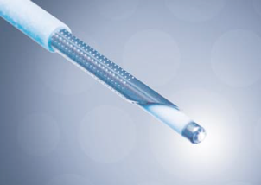
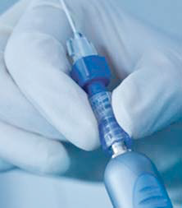
INSPECT Study 1/2
Objectives
  To define image interpretation criteria for nCLE in pancreatic cysts and evaluate their diagnostic efficiency retrospectively
  To validate the safety of nCLE in pancreatic cysts
nCLE probe in 19G FNA needle
Study Design
  Prospective observational multi-center registry (8 centers)
  Enrolled 65 patients
  Probe introduced via 19G needles
  Clinical, EUSFNA and nCLE data collected prospectively
  Gold standard: surgical pathology if available, consensus final diagnosis otherwise
nCLE probe locked on 19G needle
Konda V.J. et al. A pilot study of in vivo identification of pancreatic cystic neoplasms with needle-based confocal laser endomicroscopy under endosonographic guidance. Endoscopy 2013

Slide 30
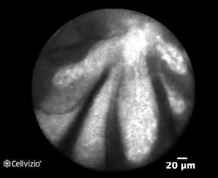
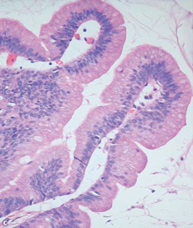
INSPECT Study 2/2
Results
First classification in pancreatic cysts defined, with one specific criteria outlined for IPMNs: papillary projection
Potential for the differentiation of mucinous and non-mucinous cysts
Safety demonstrated with a pancreatitis rate at 3% (lower than in previous study, thanks to safety measures such as locking device usage, and pre-loading of probe in needle)
Differentiation of mucinous and non-mucinous cysts
The Papillary Projection criterion in an IPMN
Konda V.J. et al. A pilot study of in vivo identification of pancreatic cystic neoplasms with needle-based confocal laser endomicroscopy under endosonographic guidance. Endoscopy 2013

Slide 31
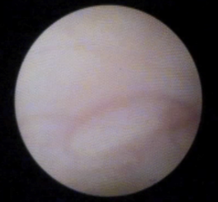
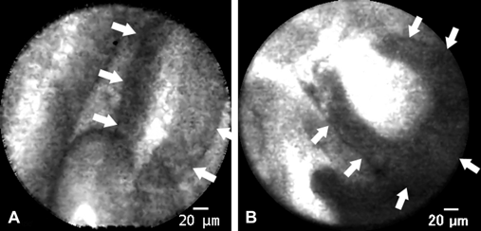
DETECT Study 1/2
Objectives
  Determine the feasibility and safety of EUS-guided dual “through-the-needle” imaging and identify specific imaging features which may correlate with mucinous vs non-mucinous cysts
Study Design
  Prospective observational study in a single center
  Enrolled and evaluated 30 patients
  Cystoscopy (Spyglass through the needle imaging) and nCLE probes introduced via 19G needles
  Clinical, EUSFNA and nCLE data collected prospectively
  Gold standard: surgical pathology if available, consensus final diagnosis otherwise
Papillary projections in an IPMN
Nakai Y, et al. Diagnosis of pancreatic cysts: EUS-guided, through-the-needle confocal laser-induced endomicroscopy and cystoscopy trial: DETECT study. Gastrointestinal Endoscopy, 2015

Slide 32
DETECT Study 2/2
Results
Potential for the differentiation of mucinous and non-mucinous cysts:
  The accuracy of nCLE for differentiating mucinous from non-mucinous cyst in all patients is 87%, compared to 73% for EUS morphology, and 61% for CEA
Differentiation of mucinous and non-mucinous cysts
All patients (n=30) | Sensitivity | Specificity | PPV | NPV | Accuracy
EUS morphology | 65 % | 85 % | 85 % | 65 % | 73 %
CEA > 192ng/mL | 33 % | 92 % | 83 % | 55 % | 61 %
Cystoscopy | 71 % | 100 % | 100 % | 72 % | 83 %
nCLE | 77 % | 100 % | 100 % | 77 % | 87 %
nCLE + Cystoscopy | 88 % | 100 % | 100 % | 87 % | 93 %
Nakai Y, et al. Diagnosis of pancreatic cysts: EUS-guided, through-the-needle confocal laser-induced endomicroscopy and cystoscopy trial: DETECT study. Gastrointestinal Endoscopy, 2015

Slide 33
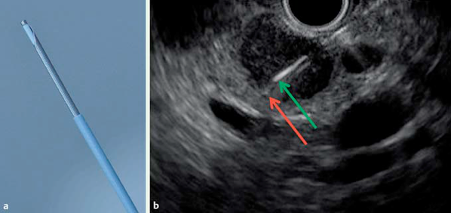
CONTACT 1 Study 1/2
Objectives
  To define specific nCLE image interpretation criteria for in vivo characterization of serous cystadenomas and evaluate their diagnostic efficiency
Study Design
a: nCLE probe protruding from a 19G needle
b: EUS image of a cyst, showing the needle puncturing the cyst. Green arrow: tip of the needle. Red arrow: tip of the nCLE probe.
  Prospective observational multi-center study (4 centers)
  31 patients enrolled and evaluated
  Probe introduced via 19G needles
  Clinical, EUSFNA and nCLE data collected prospectively
  Final diagnosis based on surgical pathology if available, consensus final diagnosis otherwise
  2 Phases: 1. Definition of a new criteria for serous cystadenomas, 2. Offline evaluation of accuracy and interobserver agreement for previously identified criteria (6 observers)
Napoléon B, et al. A novel approach to the diagnosis of pancreatic serous cystadenoma: needle-based confocal laser endomicroscopy. Endoscopy 2015.(CONTACT)

Slide 34
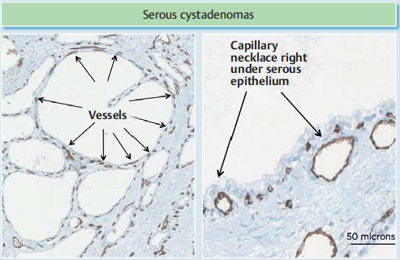
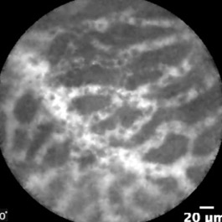
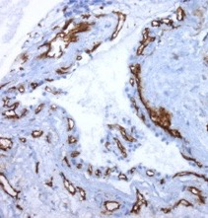
CONTACT 1 Study 2/2
Results
Validation of a new criteria, called the superficial vascular network
100% specificity and substantial interobserver agreement (kappa=0.69) for the characterization of serous cystadenomas
Characterization of Serous Cystadenoma
The Superficial Vascular Network criterion in a Serous Cystadenoma
Napoléon B, et al. A novel approach to the diagnosis of pancreatic serous cystadenoma: needle-based confocal laser endomicroscopy. Endoscopy 2015.(CONTACT)

Slide 35
CONTACT 1 nCLE classification Study 1/2
Objectives
  To determine new nCLE criteria for the diagnosis of pancreatic cystic lesions, to propose a comprehensive nCLE classification for the characterization of those lesions, and to carry out a first external retrospective validation
Study Design
  Retrospective observational multi-center study (4 centers, 6 observers)
  33 patients evaluated (from CONTACT 1 prospective study)
  Clinical, EUSFNA and nCLE data collected prospectively
  Final diagnosis based on surgical pathology if available, consensus final diagnosis otherwise
Napoléon B, et al. In vivo characterization of pancreatic cystic lesions by needle-based confocal laser endomicroscopy (nCLE): proposition of a comprehensive nCLE classification confirmed by an external retrospective evaluation. Surg Endosc. 2015.

Slide 36
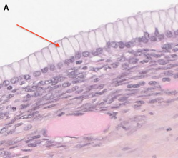
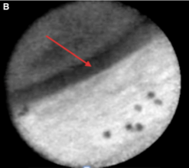
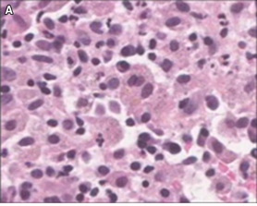
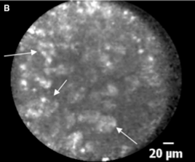
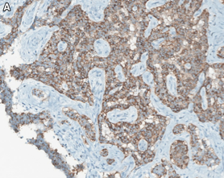
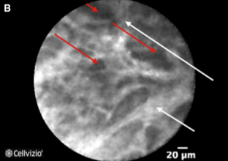
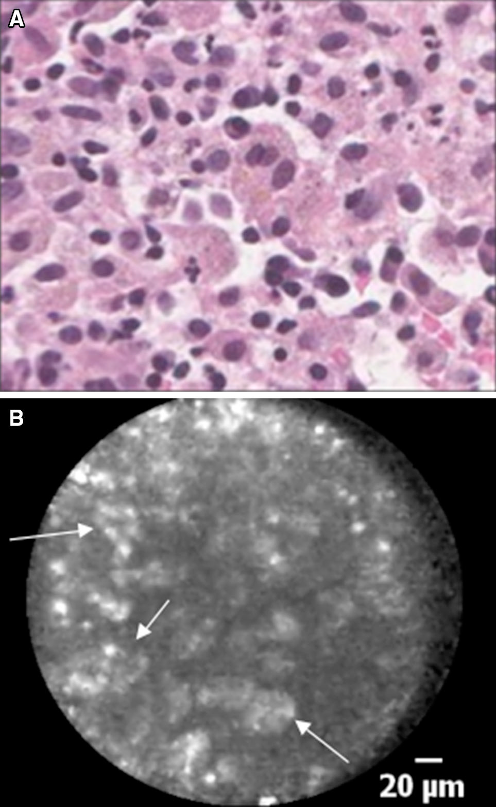
CONTACT 1 nCLE classification Study 2/2
Results
Description and validation of new criteria for Mucinous Cystadenoma, Pseudocysts and cystic Neuroendocrine neoplasm
High accuracies for all types of cysts: 90% for MCN, 90% for IPMN, 87% for SCA, 87% for PC, with very high specificities ranging from 90% to 100%
Mucinous cystic neoplasm (MCN), with red arrows pointing to the epithelial border criterion
Pseudocyst (PC), with arrows pointing to bright gray particles (inflammatory cells)
Cystic neuroendocrine neoplasm (NEN), with arrows pointing to neoplastic cell clusters surrounded with fibrous areas
Napoléon B, et al. In vivo characterization of pancreatic cystic lesions by needle-based confocal laser endomicroscopy (nCLE): proposition of a comprehensive nCLE classification confirmed by an external retrospective evaluation. Surg Endosc. 2015.

Slide 37
Colorectal Lesions

Slide 38
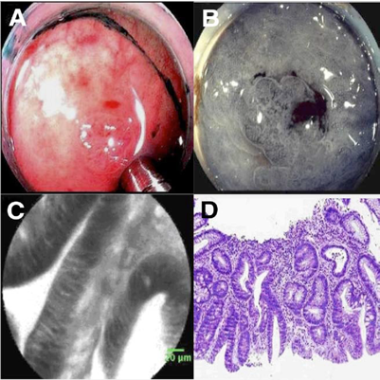
Buchner et al. Study on Characterization of polyps 1/2
Objectives
  To compare sensitivity and specificity of pCLE to virtual chromoendoscopy for classification of colorectal polyps using histopathology as a gold standard.
Study Design
  Prospective single-center controlled study
  75 patients enrolled, with 119 polyps analyzed
  Surface pit pattern of all polyps was determined in vivo using virtual chromoendoscopy (VCE, either NBI or FICE)
  Recorded confocal videos were analyzed offline, blinded to endoscopic characteristics and histopathology
  pCLE images were classified as neoplastic or benign
Images of tubular adenoma
A: Endoscopic image
B: FICE image
C: pCLE image
D: Histopathology image
Buchner A. et al., Comparison of Probe-Based Confocal Laser Endomicroscopy With Virtual Chromoendoscopy for Classification of Colon Polyps. Gastroenterology 2010

Slide 39
Buchner et al. Study on Characterization of polyps 2/2
Results
pCLE demonstrated higher sensitivity compared to VCE when considering histopathology as the gold standard with similar specificity
pCLE may avoid the need for ex vivo histological confirmation of small polyps
Classification of colorectal polyps
All locations (n=119) Prevalence: 68% | Sensitivity | Specificity | PPV | NPV | Accuracy
VCE | 77 % | 71 % | Not published
pCLE | 91 % | 76 %
p=0.01
p=0.77
Buchner A. et al., Comparison of Probe-Based Confocal Laser Endomicroscopy With Virtual Chromoendoscopy for Classification of Colon Polyps. Gastroenterology 2010

Slide 40
Shahid et al. Study on Colorectal EMR follow-up 1/2
Objectives
  To estimate and compare the accuracy of virtual chromoendoscopy (VCE) and pCLE, for detection of residual neoplastic tissue at the site of prior EMR
Study Design
  Prospective, blind comparison of advanced endoscopic imaging (VCE and pCLE)
  using matching histology as reference standard
  Three tertiary-care referral hospitals
  92 participants underwent follow-up colonoscopies for the evaluation of prior EMR sites within one year (129 EMR scars analyzed)
Shahid M. et al., Diagnostic accuracy of probe-based Confocal Laser Endomicroscopy (pCLE) in detecting recurrence of colorectal neoplasia after endoscopic mucosal resection. GIE 2011

Slide 41
Shahid et al. Study on Colorectal EMR follow-up 2/2
Results
Adding pCLE increases sensitivity and NPV to 100% for the detection of residual neoplasia
Combination of VCE and pCLE could avoid repeat colonoscopy thanks to real-time re-treatment instead of empiric re-treatment
Detection of residual neoplasia at follow-up
All locations (n=129) Prevalence: 22% | Sensitivity | Specificity | PPV | NPV | Accuracy
VCE | 72 % | 78 % | 49 % | 91 % | 77 %
pCLE | 97 % | 77 % | 55 % | 99 % | 81 %
VCE and pCLE (n=95 cases where pCLE & VCE in agreement) | 100 % | 91 % | 80 % | 100 % | 94 %
Shahid M. et al., Diagnostic accuracy of probe-based Confocal Laser Endomicroscopy (pCLE) in detecting recurrence of colorectal neoplasia after endoscopic mucosal resection. GIE 2011

Slide 42
Inflammatory Bowel Diseases

Slide 43
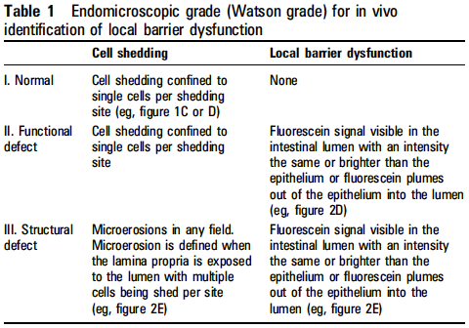
Kiesslich et al. Study on Local Barrier dysfunction 1/2
Objectives
Determine whether cell shedding and barrier loss in humans can be detected by confocal laser endomicroscopy (CLE)
Determine if these parameters predict relapse of IBD
Study Design
  Single center prospective controlled study
  Evaluated 58 patients with IBD (47 patients with UC + 11 patients with Crohn’s disease)
  eCLE was performed in IBD and control patients
  Grading system based on appearances at eCLE was devised and used to predict relapse
Kiesslich R. et al. Local Barrier Dysfunction Identified by Confocal Laser Endomicroscopy Predicts Relapse in Inflammatory Bowel Disease. Gut, 2012.

Slide 44
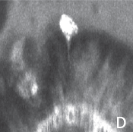
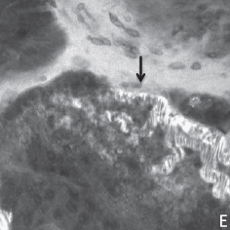
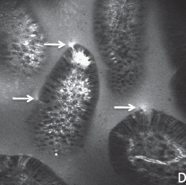
Kiesslich et al. Study on Local Barrier dysfunction 1/2
Results
Cell shedding and barrier loss detected by confocal endomicroscopy predicts relapse of IBD and has potential as a diagnostic tool for the management of the disease
Single epithelial cell shedding
Local barrier dysfunction: microerosion
Prediction of flares in IBD patients in clinical remission
Local barrier dysfunction: multiple cell shedding
Kiesslich R. et al. Local Barrier Dysfunction Identified by Confocal Laser Endomicroscopy Predicts Relapse in Inflammatory Bowel Disease. Gut, 2012.

Slide 45

Atreya et al. Study on therapeutic response in CD 1/2
Objectives
Evaluate whether the use of CLE molecular imaging with a fluorescent antibody to Tumor Necrosis Factor (TNF) could predict therapeutic responses to biological treatment in Crohn’s Disease (CD)
Study Design
  Single center, prospective observational study in 2 phases
  Quantitative measurement of ex vivo eCLE molecular imaging with fluorescent antibody to TNF
  Quantitative measurement of in vivo molecular imaging of intestinal TNF immune cells on 25 patients with active Crohn’s disease and comparison with the clinical outcome
Atreya J. et al. In vivo imaging using fluorescent antibodies to tumor necrosis factor predicts therapeutic response in Crohn’s disease. Nature Medicine, 2014

Slide 46


Atreya et al. Study on therapeutic response in CD 1/2
Results
Membrane bound tumor necrosis factor (mTNF) were imaged using fluorescent antibodies to TNF
Quantitative analysis of the eCLE images revealed that CD patients with high amounts of mTNF showed significantly higher short term response rates to therapy, compared to patients with low amounts of mTNF
This method provides a sensitivity of 84.6% and a specificity of 91.7% for the prediction of response to adalimumab therapy.
Prediction of therapeutic response in CD patients
Molecular imaging upon topical administration of fluorescent adalimumab to the inflamed gut of patients with Crohn’s disease in vivo yielded specific signals for mTNF+ mucosal cells (arrows)
Atreya J. et al. In vivo imaging using fluorescent antibodies to tumor necrosis factor predicts therapeutic response in Crohn’s disease. Nature Medicine, 2014

